Slide 1
Network Security & Threats

Slide 2
TCP/IP NETWORK MODEL
TCP/IP (Transmission Control Protocol / Internet-working Protocol) is a hierarchical protocol model made up of interactive modules.
Each module provides a specific functionality, but the modules are not necessarily interdependent.
The original TCP/IP protocol suite was defined as four software layers built upon the hardware. Today, however, TCP/IP is thought of as a five-layer model as shown.
Each layer defines a part of the process of moving information across a network in bottom-up approach.
PROCESS / APPLICATION
INTERNET
DATA LINK LAYER
TRANSPORT
PHYSICAL LAYER

Slide 3
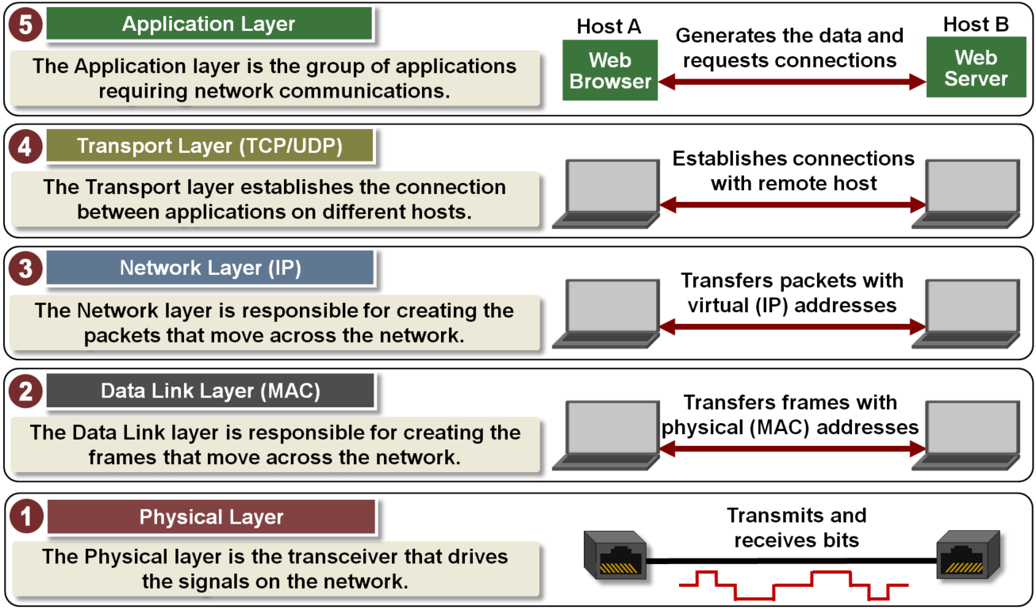
TCP/IP NETWORK MODEL

Slide 4
OSI NETWORK MODEL
The OSI model is a layered framework for the design of network systems that allows communication between all types of computer systems.
It consists of seven separate but related layers, each of which defines a part of the process of moving information across a network in bottom-up approach.
The OSI model is composed of seven ordered layers.
The OSI model allows complete interoperability between otherwise incompatible systems.
APPLICATION
PRESENTATION
SESSION
NETWORK
TRANSPORT
DATA LINK
PHYSICAL

Slide 5
OSI NETWORK MODEL
To allow access to network resources
APPLICATION
To translate, encrypt, and compress data
PRESENTATION
To establish, manage, and terminate sessions
SESSION
To provide reliable process-to-process message delivery and error recovery
TRANSPORT
To move packets from source to destination; to provide internetworking
NETWORK
To organize bits into frames; to provide hop-to-hop delivery
DATA LINK
To transmit bits over a medium; to provide mechanical and electrical specifications
PHYSICAL

Slide 6
TYPES OF THREATS
External Threats
Structured Threats
Structured attacks come from technically competent attackers who belong to a class of highly motivated individuals. They understand vulnerabilities and develop sophisticated tools and techniques to penetrate without anyone knowing.
Unstructured Threats
These threats are from inexperienced individuals testing their skills using some of the tools available in the public domain. Sometimes, these can do serious damage to company assets.

Slide 7
COMMON SECURITY THREATS
Information Gathering
Denial-of-Service Attacks
Spoofing
Man-in-the-Middle Attacks
Sniffing & Eavesdropping
Cache Poisoning Attacks
Password Attacks
Malware Attacks
Social Engineering Attacks

Slide 8
CATEGORIES OF NETWORK DEVICES
APPLICATION
Gateway
(Router or Firewall)
TRANSPORT
NETWORK
Router or L3 Switch
DATA LINK
Bridge or L2 Switch
PHYSICAL
Repeater or Hub

Slide 9
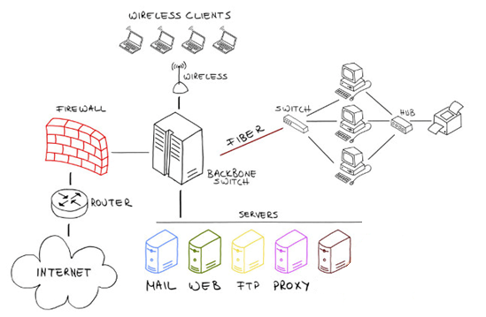
DEFINING PERIMETER SECURITY
A perimeter is the fortified boundary of the network that might include the following aspects:
Border Routers
Firewalls
Proxy, Load Balancer and VPN
IDS/IPS
Honeypots
Protocol Analyzers
SIEM

